Slide 1
OSINT
Beware. Your data is out there.
0xoposec – 19/01/2023
Notes:
OK

Slide 2
Aviso Legal & Leis
Notes:
OK

Slide 3

Aviso Legal Disclaimer - Boring but necessary
Toda a informação contida nesta apresentação destina-se exclusivamente para fins educacionais e de consciencialização.
Apresentação ao vivo. Não é um ambiente controlado e alguns conteúdos podem ser inapropriados para alguns participantes.
Declino qualquer responsabilidade pelo uso, uso indevido, download, ou visualização dos links desta apresentação.
Esta apresentação não está relacionada com o meu trabalho ou empregador.
Notes:
OK

Slide 4
Aviso Legal Disclaimer - Avoid illegal activities
Alguns links, sites, software ou outros itens listados podem ou não ser legais, delito, crime no seu país.
Por favor, verifque que lhe é permitida a consulta dos sites, e o eventual uso do software listado.
Ignorância acerca das leis aplicáveis não é desculpa para transgressões ou actividades ilegais.
Atividades ilegais podem implicar problemas ou mesmo prisão.
Verifique sempre o que é legal e as leis aplicáveis.
Notes:
Exemplo: Reverse engineering é/era illegal em alguns países - German Trade Secrets Act (TSA)

Slide 5
Leis Portuguese Law and Organizations
Lei
Diário República Eletrónico (link)
ANACOM (link)
Organizações
CNCS – Centro Nacional de Cibersegurança (link)
Incident Notification (link)
CERT.PT (link)
Unidade Nacional de Combate ao Cibercrime e à Criminalidade Tecnológica (UNC3T) (link)
Ministério Público (link)
Notes:
OK

Slide 6
OSINT Time
Notes:
OK

Slide 7
OSINT – Open-source intelligence Digital Footprint
Open-source intelligence (OSINT) consiste na recolha e análise de dados obtidos de fontes disponíveis ao público em geral, como jornais, revistas científicas e comunição social para produzir informação inteligente.
Colecionar dados de:
motores de busca (Google, …)
redes sociais (Facebook, …)
sites governamentais
mapas
…
E depois extrair/relacionar/inferir nova informação com maior valor/potencial.
Notes:
OK

Slide 8
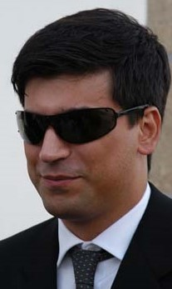
Who Am I Let’s OSINT me ☺
Just got a name
Pedro António Oliveira Vieira
Google (link)
Google “Improved Search” (link)
Google “Improved Search” (link)
LinkedIn (link)
Public profile was showing way too much
Certified Ethical Hacker (link)
My github notes (link)

Slide 9
Search Engines Internet is more than Google
Motores de busca diferentes → regras/crawlers diferentes → resultados diferentes
Google (link)
Bing (link)
Yahoo (link)
DuckDuckGo (link)
Baidu (China) (link)
Yandex (Russia) (link)
You may ask to be removed from one search engine, not all ☹ (link)

Slide 10
Search operators Improve the search
Google Advanced Search (link)
filetype: search your results based on the file extension
cache: This operator allows you to view cached version of the web page.
allinurl: This operator restricts results to pages containing all the query terms specified in the URL.
inurl: This operator restricts the results to pages containing the word specified in the URL
allintitle: This operator restricts results to pages containing all the query terms specified in the title.
link: This operator searches websites or pages that contain links to the specified website or page.
info: This operator finds information for the specified web page.
location: This operator finds information for a specific location.
42 Advanced Operators (link)

Slide 11
Search Dork Examples – Curriculum Vitae
Google Search (link)
Google Search - List site/directories contents (link)
“curriculum vitae” filetype:pdf inurl:upload
“curriculum vitae” – keywords to look for
filetype:pdf - only pdf files
inurl:upload
Available information on pay slips “recibo de vencimento” (link)
Full name, address, nif, nib, marital status, number of children, ...
Notes:
Check cache instead of opening the link

Slide 12
Search Dork Examples - Hacked
Google Search (link)
“hacked by” site:pt
“hacked by” - keyword to look for
site:pt - only “portuguese” sites (registered portuguese domains)
About 13.400 results
Sites / pages that were “tagged”/”signed”
Attack and contents changed to show off skills (mainly kids) – compared to street tagging

Slide 13
Google Dorks Commonly used searches
Google Hacking Database (link)
gbhackers (link)
google-dork-list (link)
Google Advanced Operators Guide (link)
Google Advanced Operators Reference (link)

Slide 14
OSINTing

Slide 15
OSINT yourself How the internet sees YOU
Search your name on Google and analyze the results
As you saw the search can be improved
Some results can/will include:
Family and Friends
Work
School grades
BI - Identity Card Number (yes)
NIF – Tax Identification Number
That is typically information to verify your identity over a phone call.

Slide 16
OSINT Portugal – Vehicle Information
Automóvel On-line (link)
Certidão Permanente Automóvel (link)
License Plate : “89-QS-04” (link)
Result
Brand: MERCEDES-BENZ
VIN: WDD2221631A248762
Example (link)
Vehicle Information (link)
Example (link)
Information: Brand, Model, Location, Paint, Delivery Date, Extras, …
Hack across the globe by VIN (link)

Slide 17
OSINT Portugal –Insurance Information
ASF – Autoridade de Supervisão de Seguros e Fundos de Pensões (link)
Example (link)
License Plate : “01-EF-34”
Date : “03-07-2022”
Example 2 (link)
License Plate : “01-EF-34”
Date : “03-07-2012”
Insurance Company
Current and Past
Length of the contract
Insurance policy number
Is it possible to get information for all license plates ????

Slide 18
OSINT Portugal Specific
DGES - Direção-Geral de Ensino Superior (link) (link)
DGAE - Direção – Geral da Administração Escolar (link)
DRE - Diário da República (link)
Search DRE (link)
Ministério da Justiça – Publicações (link)
Instituto Nacional da Propriedade Industrial (link)
Notes:
Farfetch - 507398505
BLIP - 510148301

Slide 19
OSINT Portugal Specific
Registo Predial Online (link)
Finanças - Penhorados (link)
Example (link)
Search Penhorados – (link)
Ministério da Justiça - Penhorados (link)
Plataforma Eletrónica de Compras (Administração Pública) (link)
Leaked information:
Full Names, Addresses, NIF, Company, Marital Status, …

Slide 20
OSINT Portugal – Public contracts
Base (link)
The example (link)
PDF of contract with PII strikethrough (link)
Open with pdf reader and delete the strikethrough boxes
Name of employee who edited the document
Information on UA, LinkedIn, Facebook, …
Metadata: “KONICA MINOLTA bizhub C454”
Information leaked
Full Names, nif, addresses

Slide 21
Deadly Social Media The Final Hours of Pop Smoke
Rapper Pop Smoke Murdered in Home Invasion ... By 4 Masked Gunmen (link)
Instagram Posts
Location Tag
Geolocation
Reverse Image
Google Maps
Local Recon
Airbnb/Zillow (Rent/Real-estate)
House photos (Outside and Inside)
Layout
YouTube Video: The Cyber Mentor (link)

Slide 22
OSINT Profiling Awareness
Mobile (how long have you been using the same number)
Sync me (link)
Usernames (you reuse usernames)
NameChk (link)
WhatsMyName (link)
NameCheckup (link)
Tinder
Username reuse (link)
New awesome tools are always being created

Slide 23
OSINT Profiling Awareness
What’s my IP? (link)
Ip2Location (link)
Mylocation (link)
Twitter
Twitter Advanced Search (link)
Facebook
StalkFace (link)
Sowdust Github (link)
IntelligenceX Facebook Search (link)

Slide 24
OSINT Profiling - Professional
LinkedIn (link)
Xing (link)
Curriculum Vitae
Sending CV with too much information – what is too much ☺
Home address – Street View
Company Information
Technologies described in job adds (leaking information)
Professional information phishing
Fake job adds (Is this a thing?)

Slide 25
OSINT (Reverse) Image search
One image is worth 1000 words, maybe more.
What information can be extracted from a photo ?
Google Images (link)
Bing Images (link)
Yahoo Images (link)
Tineye (link)
Yandex (link)
The professionals (video explaining) (link)

Slide 26
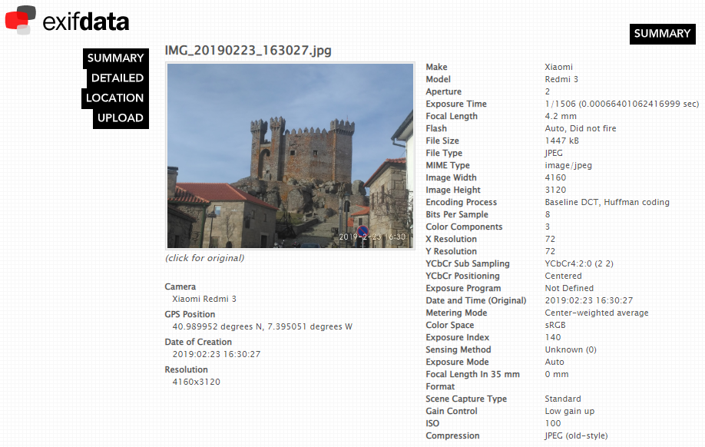
OSINT - Photos Metadata
Metadata
GPS (link)
Google Maps (link)

Slide 27
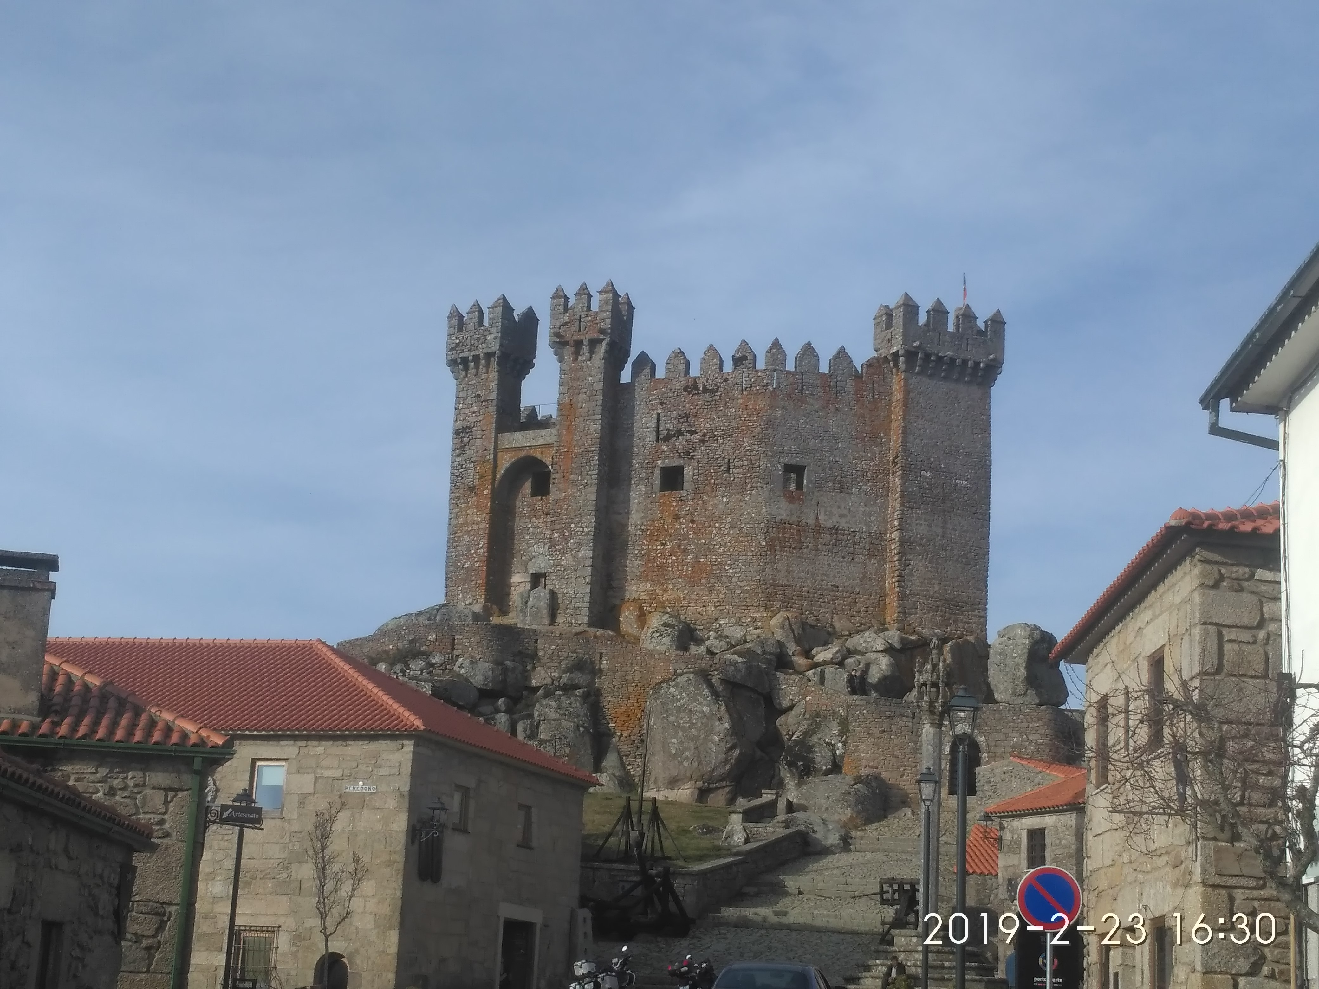
OSINT - Photos No Metadata but still lots of Information
Where was this image taken?
Have you been there?
When?
Date stamp on photo
Filename with date
Metadata
What else?
Image search
Identify the castle?
CleanUp (link)
AperiSolve (link)

Slide 28
OSINT Street View
Google Street View (link)
Identify house by address
Assess security (cameras, fences, ...)
Parked cars (timeline, ...)
People’s habits/routines, timetables, ...
View the past – timeline (link)
Instant Street View (link)

Slide 29
OSINT Maps
Google Maps (link)
Bing Maps (link)
Wikimapia (link)
DualMaps (link)
Tips, Tricks and Techniques (link)

Slide 30
Search Satellite View
Zoom Earth (link)
Satellites Pro (link)
World Imagery (link)
Wayback (link)
Wayback example (link)
View the past - timeline

Slide 31
OSINT MEMORY Internet in the past
Wayback Machine (link)
Example (link)
Archive.is (link)
Cached Pages (link)
Cached View (link)
OldWeb.Today (link)
Time Travel (link)
Github commits ☺

Slide 32
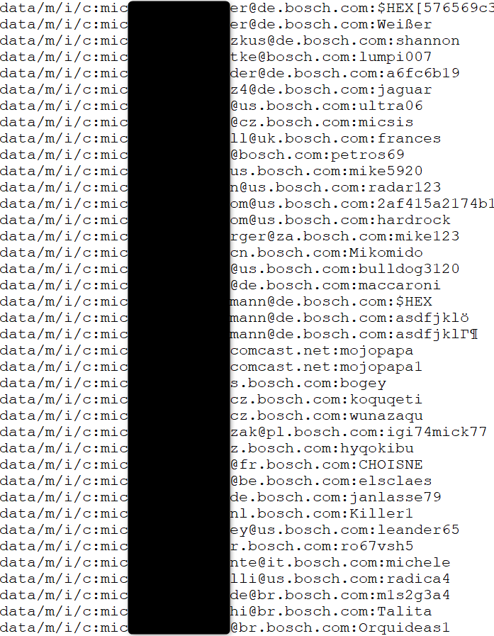
Databreach Company credentials ?
Email/Login
Password
Source
Publicly available list of credentials
More than 10k credentials just for Bosch
Information gathered
Rule of email/login
(FirstName.LastName)@(Country).(company).com
Rule of password complexity
List of users
Phishing campaigns
Brute force
Look for those users on Social Media
HaveIBeenPwned (link)

Slide 33
OSINT IOT Internet of Things
Does it have radio?
Wireless, Bluetooth, ZigBee, …
Federal Communications Commission (link)
FCCID.IO (link)
ZDER3 (internal)
Datasheets
Datasheets (link)
AllDatasheet (link)

Slide 34
Shodan Internet of Things
Remote Desktop (link)
Total results: 3,482,756
Braga (link)
Images
Braga (link)
VNC Remote Access and Loggedin (link)
Authentication Disabled
Portugal (link)
Primavera (link)
Contabilidade (link)

Slide 35
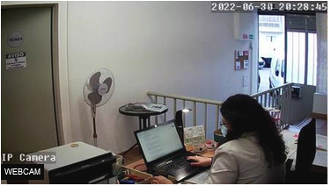
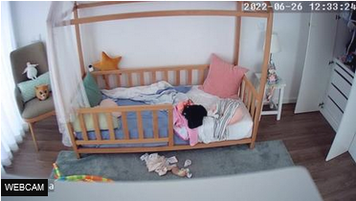
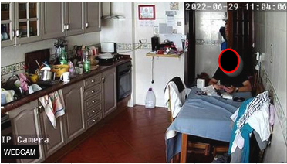
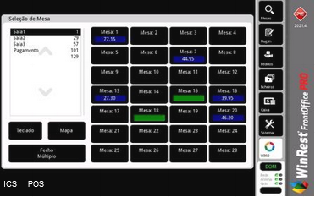
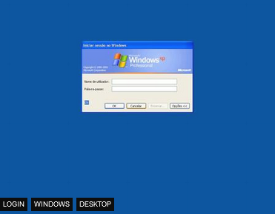
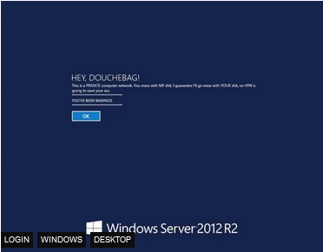
Shodan Internet of Things - Images

Slide 36
Before you start OSINTing
Don’t get under the spotlight.

Slide 37
OSINT Notes My notes and some links
My OSINT notes (link)
OSINT (Presentation)
Awareness (Presentation)
Sofia Santos - How to do a small OSINT investigation (blog) (video)
Michael Bazzel – IntelTechniques (link) (book) (magazine)
OSINT Combine (link) (bookmarks)
OSINT Dojo (link)
OSINTCurio.us (link)
OSINT Techniques (link)
Start.me pages (link) (example)
Technisette (link)
Open Source Intelligence Tools and Resources Handbook 2020 (link)

Slide 38
CTF Capture The Flag & Challenges
TraceLabs CTF (link) (notes)
Hacktoria (link) (notes)
Cyber Detective CTF (link)
Cyber Investigator CTF (link)
TryHackMe (link)
Search for OSINT (link) (notes)
Blue Team Labs Online - Cyber Range (link)

Slide 39
OSINT Sock Puppets
Name Generator (link)
Photo - thispersondoesnotexist (link)
Sim Card - Local / Country / Electronic
Credit Card - Privacy.com (link)
VPN - usefull to be some where else
Email account
Social Media accounts
Sock Puppets Tutorials
The Art Of The Sock (link)
My Process for Setting up Anonymous Sock Puppet Accounts (link)

Slide 40
OSINT Tools & more tools
OSINT FRAMEWORK (link)
Yups, only one link is all it takes. But others worth mentioning.
OSINT4ALL (link)
Intel Techniques (link)
OSINT Techniques (link)
Technisette (link)
Cyber Detective (link)
OSINT Link (link)
Aware Online (link)

Slide 41
OSINT Virtual Machines
Trace Labs VM (link)
Mandiant – Threat Pursiut VM (link)
CSI Linux (link)
Tails (link)
Kali (link)
Parrot (link)
Windows (link)

Slide 42
Free to Share

Slide 43
License
Feel free to use/modify/share
Teach someone
Improve awareness

Slide 44
Shodan Search Engine for Internet Of Things
Internet Exposure Observatory
Exposure Dashboard (link)
Explore
Shodan explore (link)
Images
Shodan images (link)
Maps
Shodan maps (link)

Slide 45
ONLINE SAFETY

Slide 46
Helping Tools Privacy
VPN (Different country, different advertisements, what else ?)
ProtonVPN (link)
Temporary Email (Need to register? Activate software?)
10 minute email (link)
20 minute email (link)
Disposable Email
60 minute email (link)
Internet Access (DarkWeb included)
Tor (link) (internet browser)
Tails (link) (OS that runs on usb or VM)

Slide 47
Helping Tools Safety
VirusTotal
Check received files (link)
(don’t upload Personal or Company related information)
Netcraft
Sitereport (link) (check for suspicious sites)
Ransomware
No More Ransom (link)
Virtual Credit Card (online shopping)
Mbnet (link)
Revolut (link)
PayPal (link)

Slide 48
Awareness

Slide 49
Awareness True stories – Healthy Meal
Someone posted a photo of healthy meal during COVID
Working remotely on in the usual business environment
Company laptop was in the background
Zoomed in and was possible to read emails
Company private information could be leaked
Personal information on other persons was showing
Social Media Apps use OCR
Means they also read the emails
And everyone else on that social media could get the same information

Slide 50
Awareness True stories – Quiet vacations
Long last deserving vacations
Too many friends at destination
So, warn no one and just relax on vacations
I posted a picture on social media
My friends were alerted I was nearby
Friends on that location called me on the phone
Everyone else knew I was not home
Burglars love that kind of information
Not public profile. At least I think it is not (rules change)
Someone could have shared the photo with the world

Slide 51
Awareness True stories – Store Credit
Buying a book for almost no money
How I was able to get money just by having the right information
Store clerk asked for store customer card
Gave mobile number and full name
Store clerk asked if I wanted to use balance credit
I accepted and little had to pay
Mobile and full name were not mine ☺

